Slide 1
ERROR HANDLING
An implementation in ASP.NET Web API

Slide 2
Errors ?
Error specification
Setting up the API : Models & Controller
Throwing and Catching
Validation Pipeline

Slide 3
Errors ?
In Web API, there are 2 kinds of errors
Server is responsible = unhandled exceptions
or deliberately ignored ones
null reference exceptions
unhandled yet client errors
dictionary not containing keys
servers desynchronizations
And many more

Slide 4
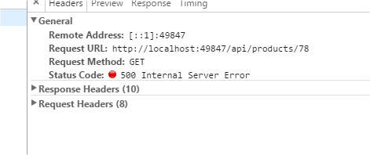
Errors ?
Server errors must return an HTTP 5XX error

Slide 5
Errors ?
Client Errors = Handled exceptions
Not found
Wrong input (technical)
Not authorized
Wrong input
(business)
Conflict

Slide 6
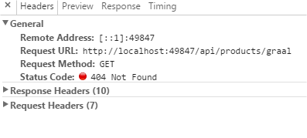
Errors ?
Client errors must return an HTTP 4XX error

Slide 7
Error Specification

Slide 8
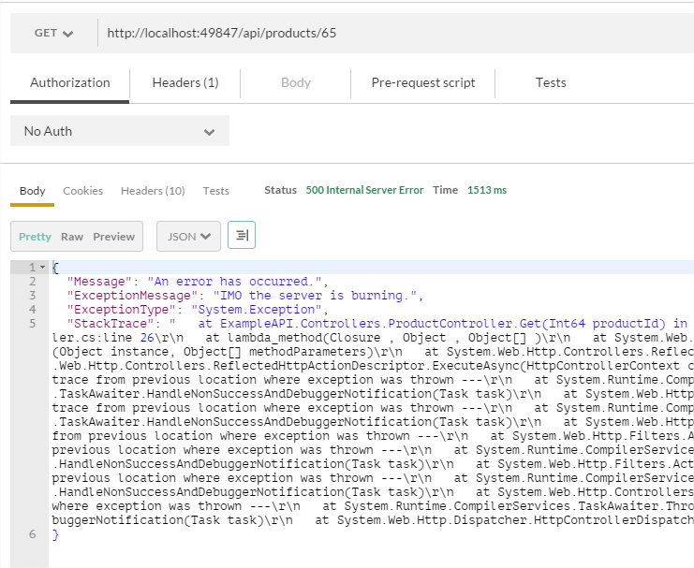
Error Specification
ASP.NET Web API has a default format for unhandled exceptions.

Slide 9
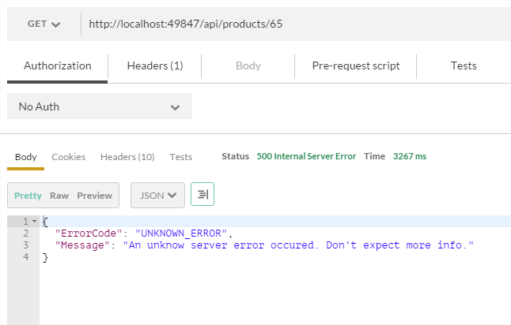
Error Specification
We prefer our own format.

Slide 10
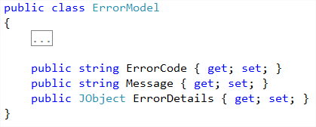
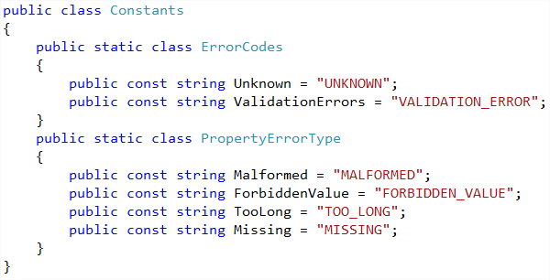
Error Specification
Front End guys / API clients prefer consistent data

Slide 11
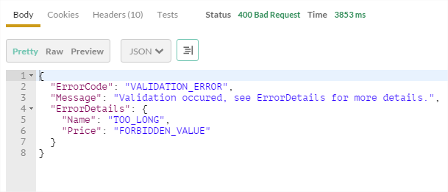
Error Specification
They probably want some validation details

Slide 12
Error Specification
We will set 3 main types of exceptions, based on 3 error scenarios
In the end, they need to fit into the ErrorModel

Slide 13
Error Specification
Server errors : no ErrorDetails. Even Message is debatable.

Slide 14
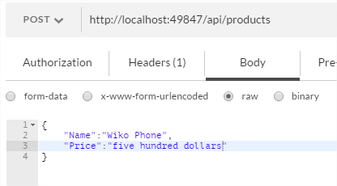
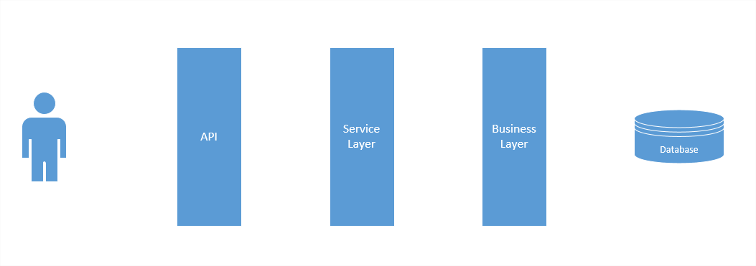

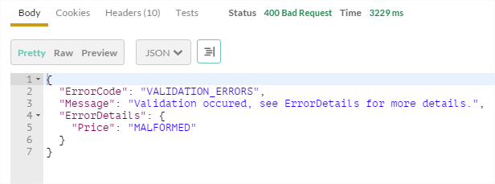
Error Specification
Client errors :
Validation errors

Slide 15
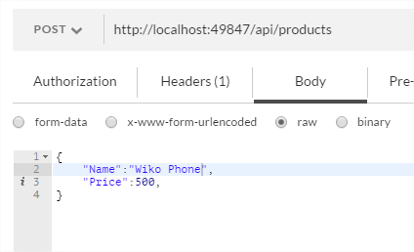
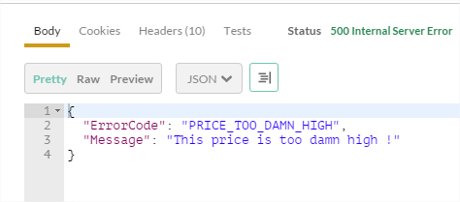
Error Specification
Client errors :
Business/Service errors

Slide 16
Setting up the API - Models & Controllers

Slide 17
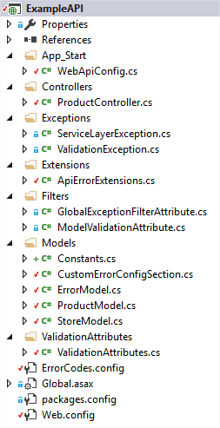
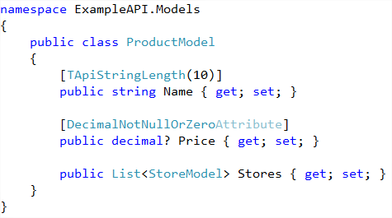
Setting up the API : Models
POCO + Validation attributes

Slide 18
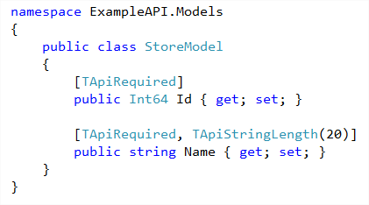
Setting up the API : Models
POCO + Validation attributes

Slide 19
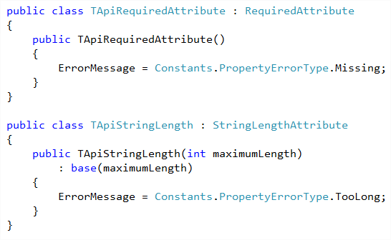
Setting up the API : model attributes

Slide 20
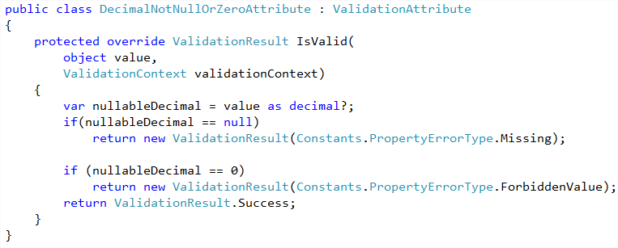
Setting up the API : model attributes

Slide 21
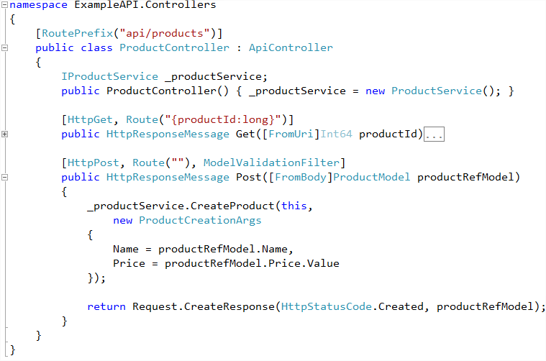
Setting up the API : Controller

Slide 22
Throwing and Catching with Filter Attributes

Slide 23
Filter Attributes
Filter attributes act as « side code » for actions
(logs, security, validation, exception handling, …)
They can be applied to (or decorating)
Single actions
Entire Controllers
A Whole API
They can run before or after the action

Slide 24
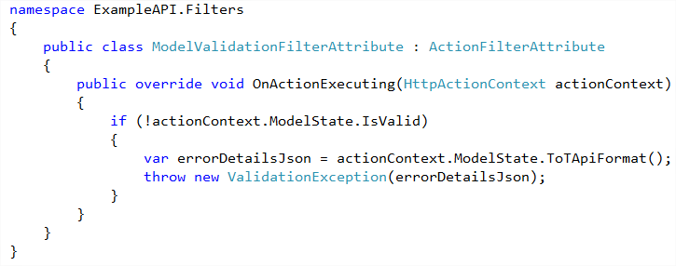

Throwing & Catching : Validation Filter

Slide 25
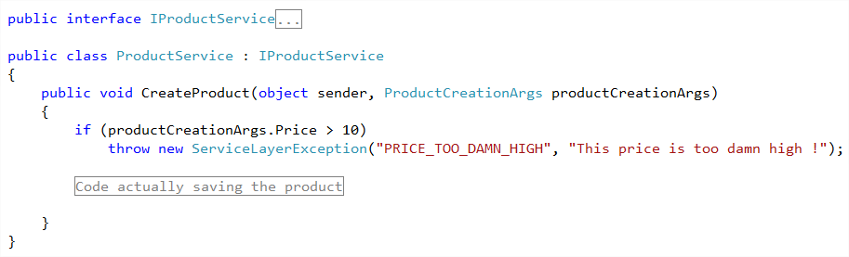

Throwing & Catching : Fake Service Layer

Slide 26
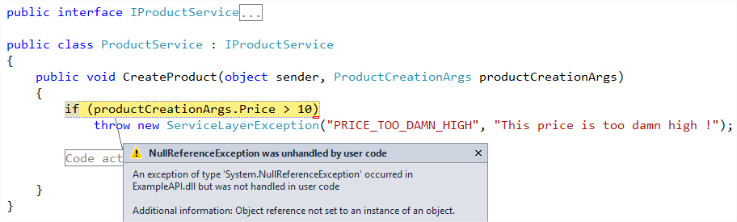

Throwing & Catching : Fake Service Layer

Slide 27
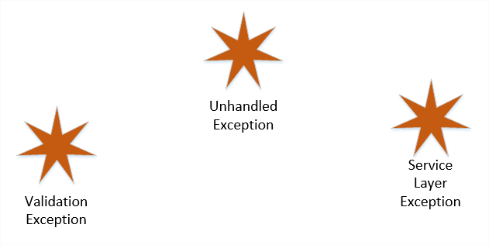
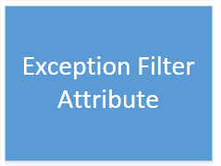
Throwing & Catching

Slide 28
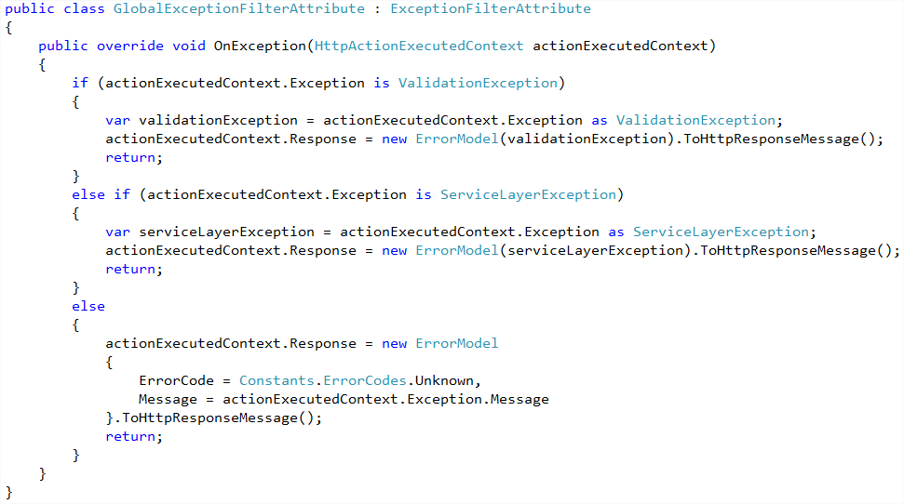
Throwing & Catching : Exception Filter Attribute

Slide 29
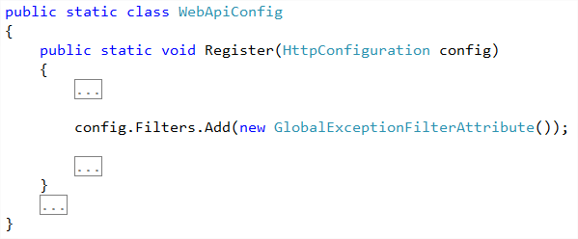
Throwing & Catching : making the filter global
The Exceptions Filter Attribute is applied to the entire API

Slide 30
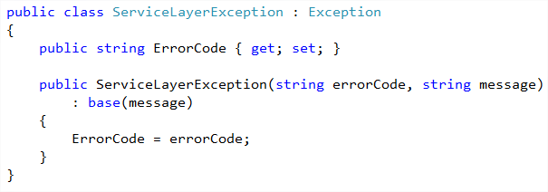
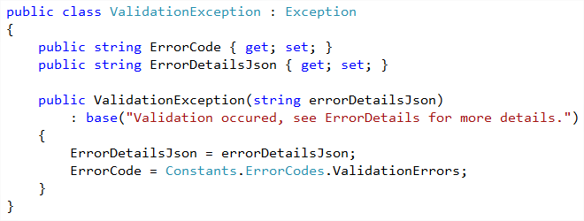
Throwing & Catching: Exceptions

Slide 31
The Validation Pipeline

Slide 32
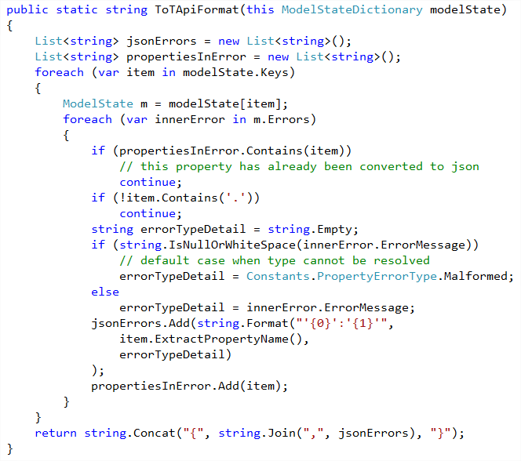
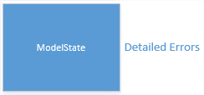
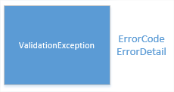
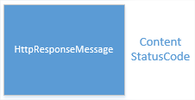
Validation Pipeline

Slide 33
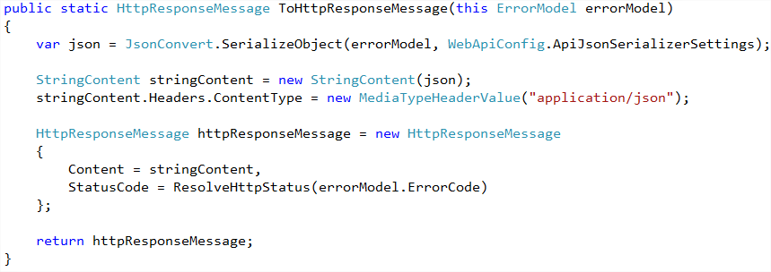
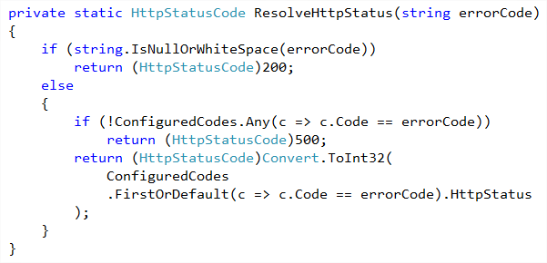
Validation Pipeline

Slide 34
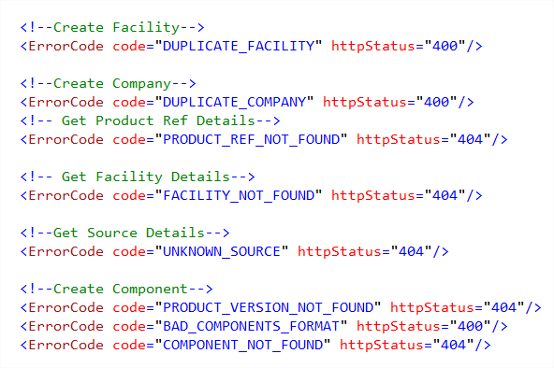
Mapping Error codes to HTTP Status

Slide 35
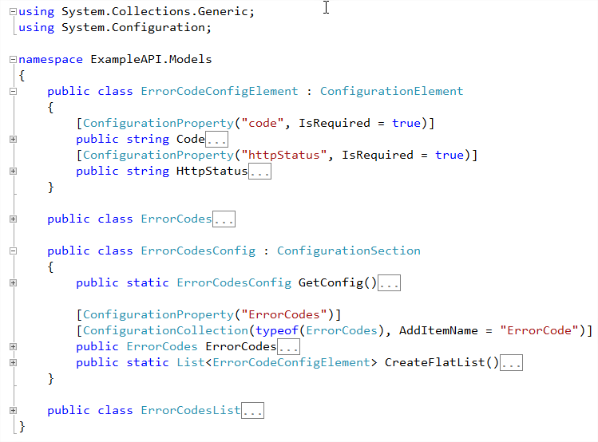
Mapping Error codes to HTTP Status

Slide 36
Areas for improvement
JSON input validation : JSON Schéma ?
Better sub objects/lists validation
HTTP Status Mapping
Using Dictionary to retrieve client error messages

Slide 37
Do you have questions ?

